Slide 1

To graduate or not to graduate – that is the question
Project 4 - Data Analytics Bootcamp
Mohammed Hamim Hussain
Hanwen Jia
Sultana Khan

Slide 2


Introduction
Using the data to predict the likelihood of a student graduating or dropping out.
The ‘Target’ column consists of ‘Graduated’, ‘Enrolled’ and ‘Dropout’
We have used Python (Pandas) to clean data, Tableau to summarise and visualise data, supervised Machine Learning and Deep Learning to do predictive modelling.

Slide 3
What data is there?
Dataset provides a view of students enrolled on various undergraduate degrees.
Includes data that can be analysed for possible predictors of academic success and student dropout.
Columns include following information:
course type
age
Gender
marital status
scholarship holder
parental qualification/occupation
whether the student is international
fees are up to date
Cirriculum units (credited/enrolled/ evaluations/approved) for two semesters
unemployment rate
GDP

Slide 4
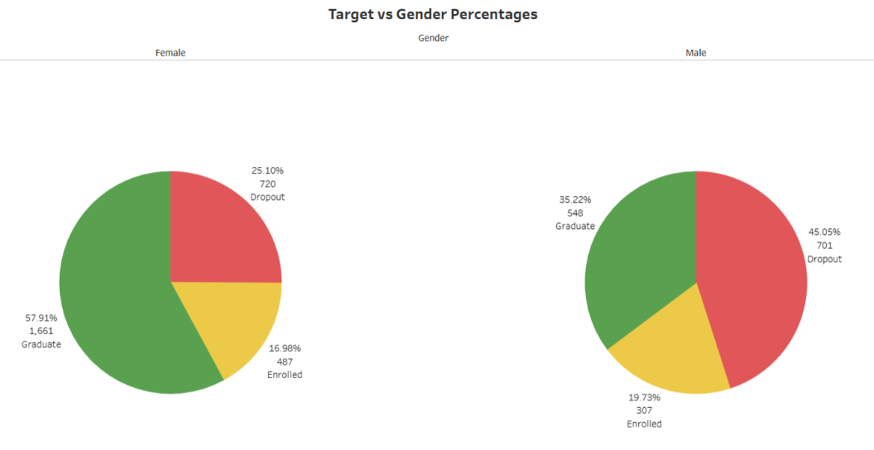
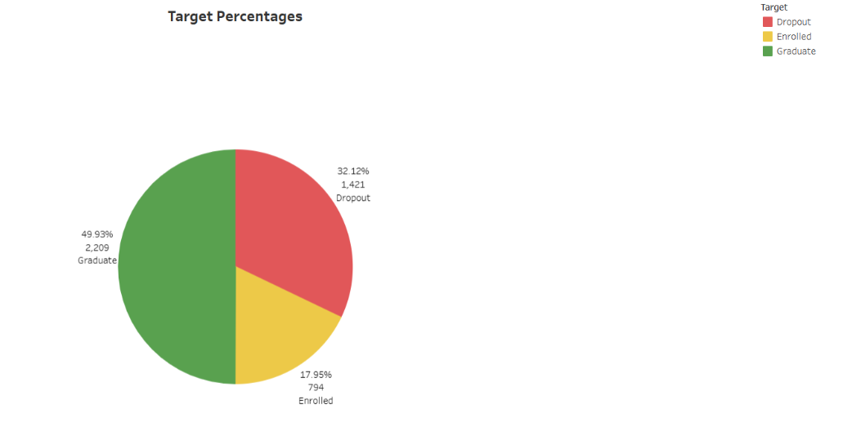
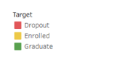
Gender & Result
Total

Slide 5
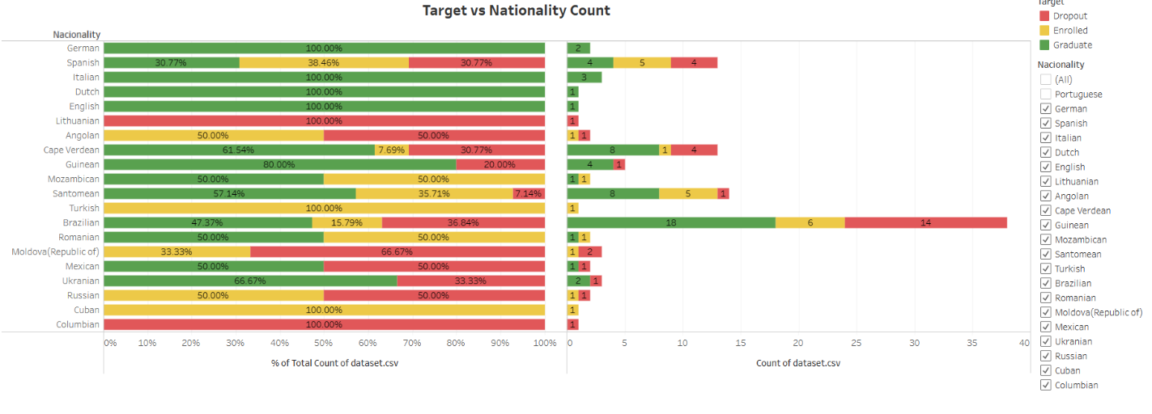
Top 5 nationalities after Portuguese

Slide 6
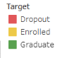
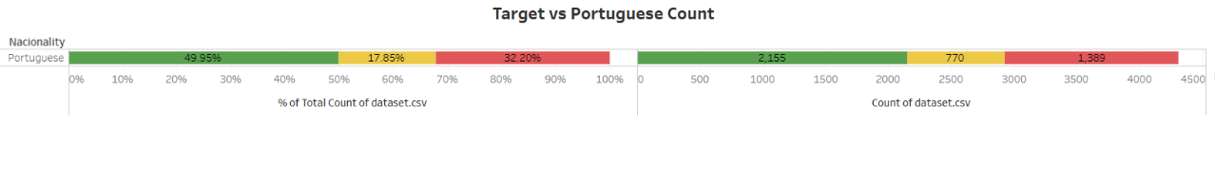
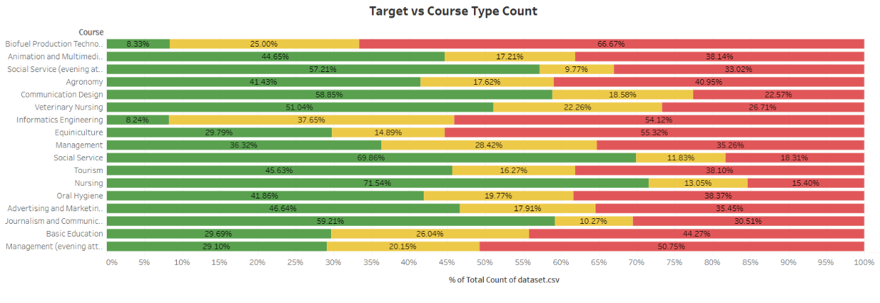
Count of Portuguese students

Slide 7
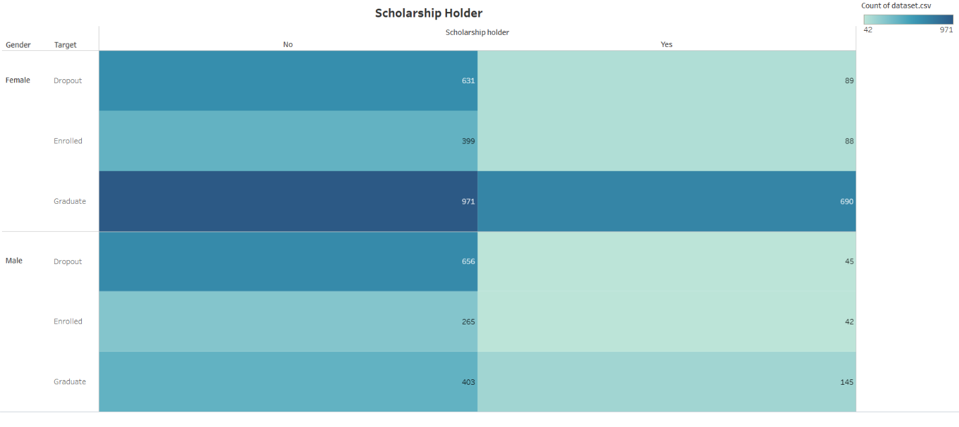
Scholarship holders – graduation numbers

Slide 8
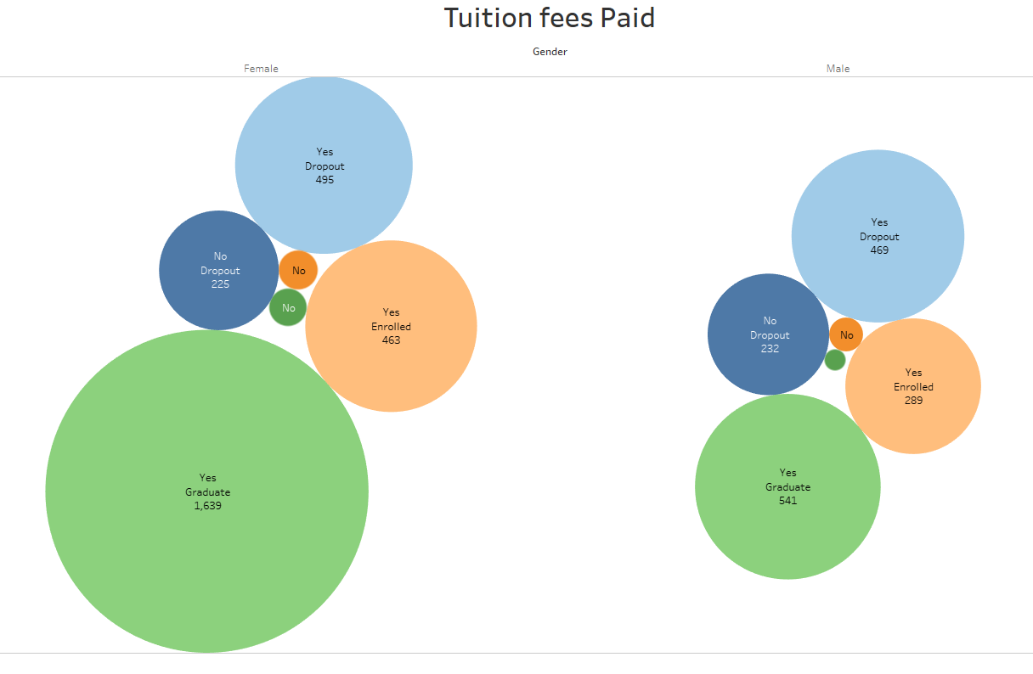
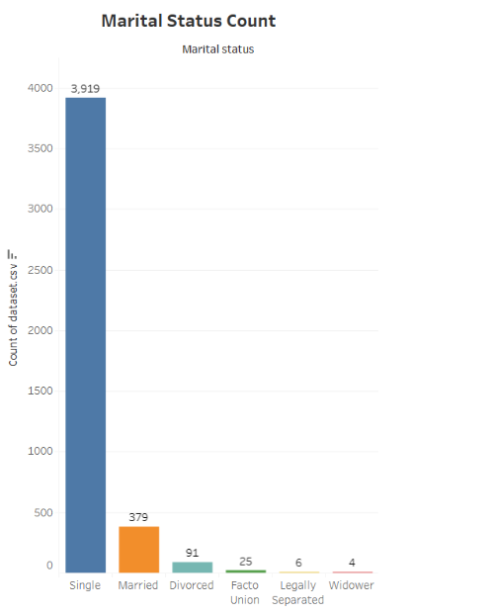
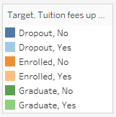
Marital status of students Tuition Fees

Slide 9
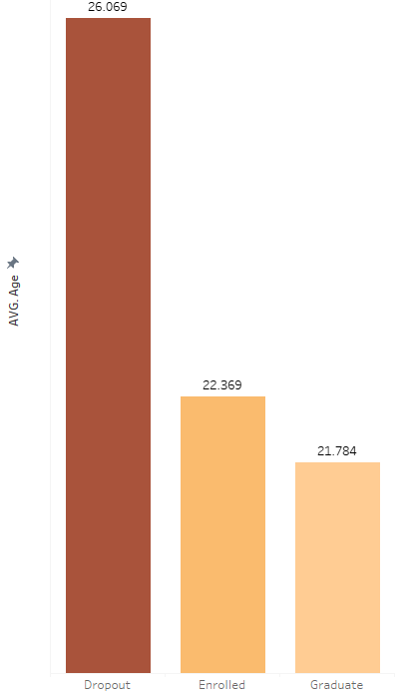
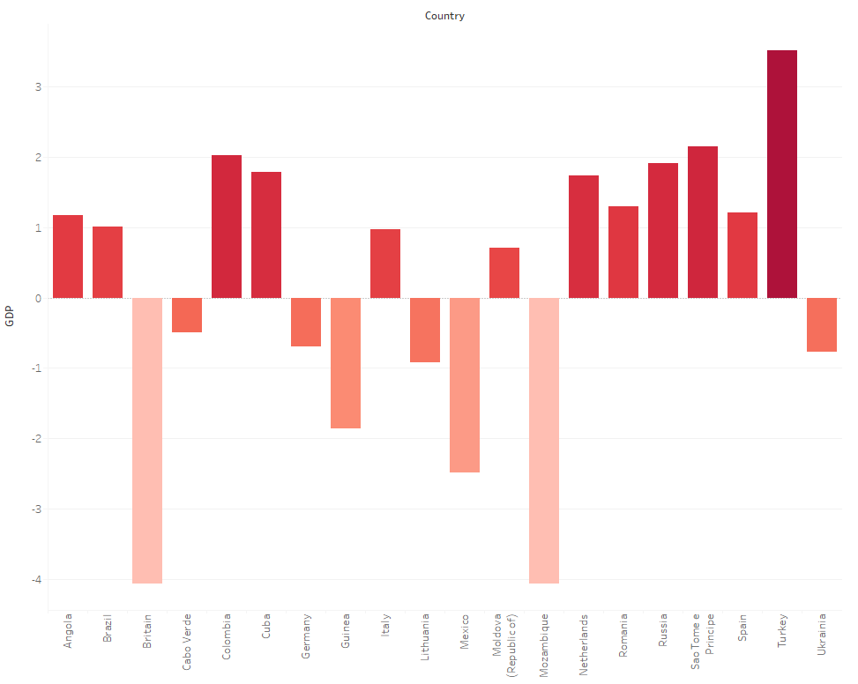
Average Age Country GDP of International Students
most of international students are from positive GDP growing Country
-----------------------------------------
younger students are more likely to gradate successful.
older students are more likely to Dropout

Slide 10
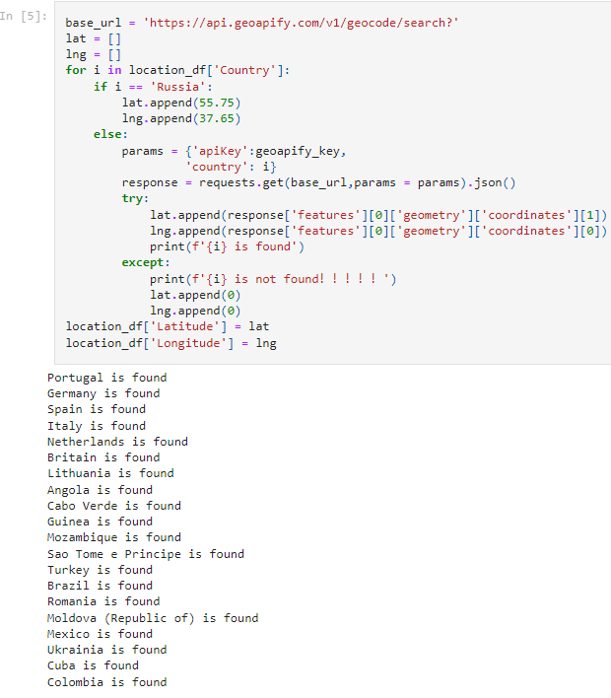
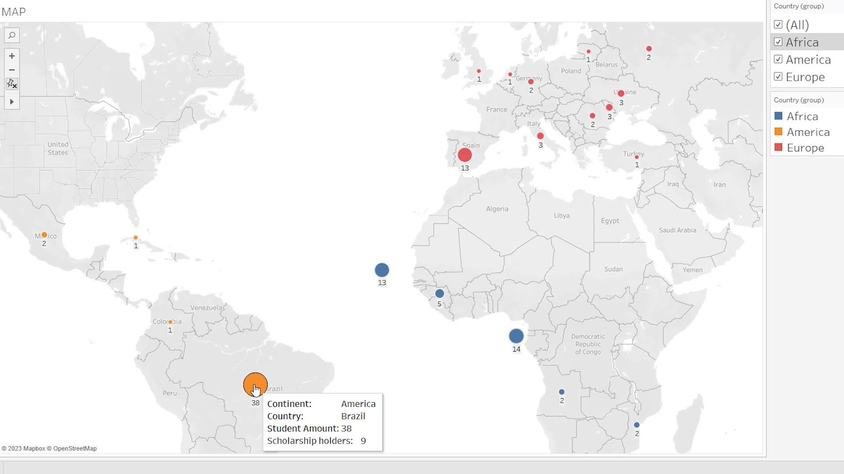
MAP CREATE
Retrieve location data via API. Create map of International students’ resources.
Also map applied continent filter and student basic information

Slide 11

What does this tell us?
Summary of data
Female students are more likely to graduate.
Majority of students are single.
Financial aid impacts the drop out rate.
Course that show the greatest graduate rates are traditional vocational.
Younger students are more likely to graduate successfully.
International students are most from nearby continents.
QUESTION:
If we can predict result of each student and help them in time to prevent dropout or enrolment?

Slide 12
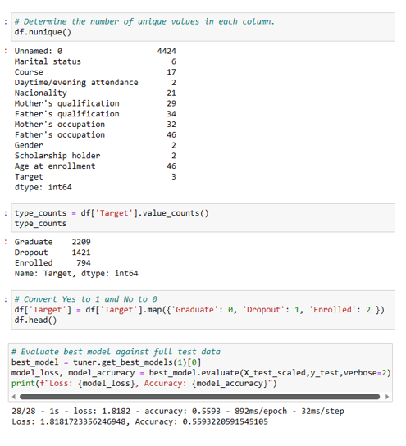
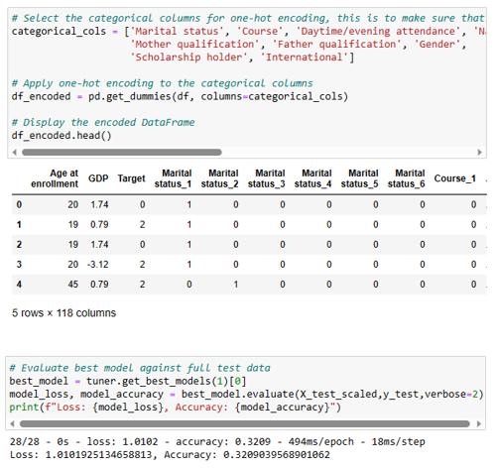
Initial Machine Learning Failures
Attempt 1: Using an Automated Neural Network Optimizer (Keras-Tuner)
Attempt 2: One-Hot Encoding the Dataset

Slide 13

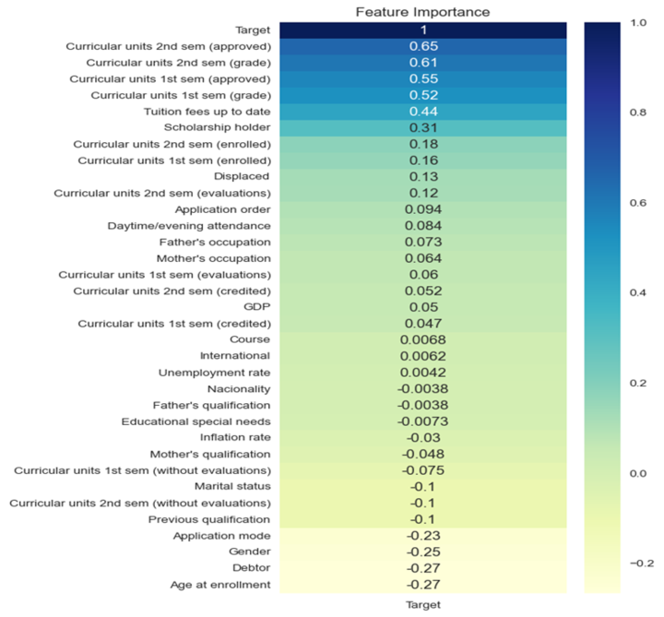
Initial Machine Learning Failures
Troubleshooting
Our dataset we had 117 columns which was too much, and this could have created a lot of noise causing the model to underfit.
High bias in the model can be caused by outliers
Or skewed data points that deviate significantly from most of the dataset.

Slide 14
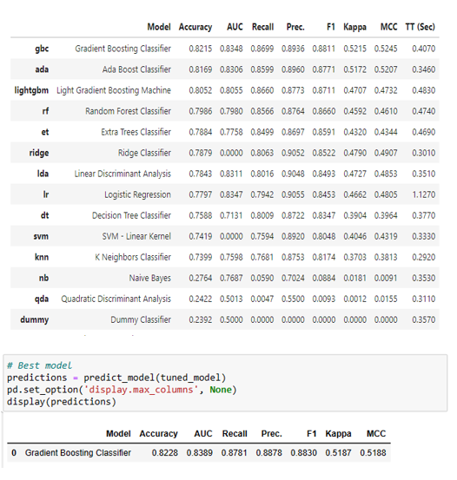

Supervised Machine Learning
PyCaret for Machine Learning
Generated a table with the best performing models, with the highest accuracy score at 0.82
Tuned the model and achieved a slight improvement to an accuracy score of 0.8228

Slide 15
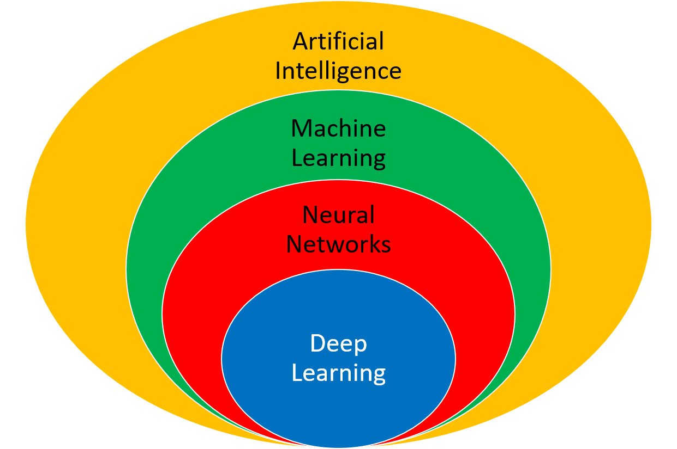
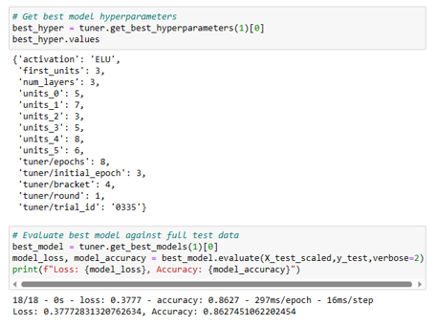
Deep Learning
Leveraging Deep Learning for Improved Predictive Accuracy
Achieved a significant improvement in accuracy with a score of 0.86
Significantly outperformed the previous PyCaret-based model

Slide 16

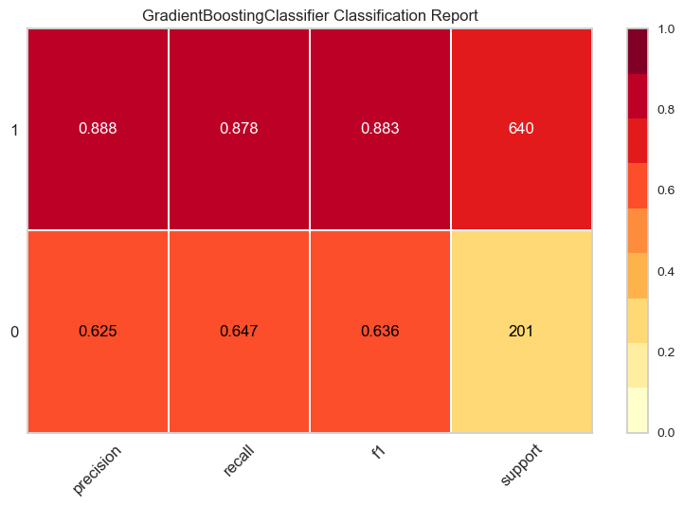
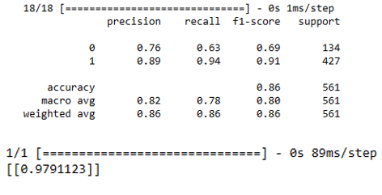
Summary of both models
Machine Learning- Pycaret
Deep Learning- Keras-Tuner
The Keras-Tuner model has higher precision values for both Class 0 (Dropout) and Class 1 (Graduate) than Pycaret model.
The Keras-Tuner model has higher recall values for Class 1 (Graduate) compared to the PyCaret model. The PyCaret model has a slightly higher recall for Class 0 (Dropout)
The Keras-Tuner model has a higher accuracy (0.86) compared to the PyCaret model (0.8228)
Overall Keras-Tuner model has a higher degree of accuracy for predicting whether a student will graduate.

Slide 17

Concluding thoughts….
Limitations on data
Who would benefit from this data?
Data duration only covered two terms
The data needs more granularity-reasons for dropout (changing courses)
Financial columns are not included in model
Lack of clarity on meaning of certain columns (Displaced & curriculum columns)
Any educational institutions for increasing student graduation rate
Students themselves
Apply more support to students and high dropout rate courses

